Slide 1


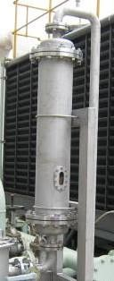
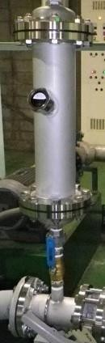
WHAT IS AMB ?
AMB is an Advance mineral Balanced that transforms the structure of water at molecular level to optimize its properties for Domestic & industrial use.
Cluster Reduction – Breaks down large water clusters into smaller ones, improving water permeability and efficiency.
Deionization of Minerals – Neutralizes mineral ions in water, preventing scale formation.
Colloid Formation – Converts scaling minerals like magnesium and calcium into soft, nonstick colloids, eliminating scale buildup.
Cat ionization of Water – Positively charges water, enhancing its
interaction with industrial systems for better performance & efficiency.
This chemical free, power free, and maintenance free solution
is ideal for industries seeking sustainable and cost-effective
water treatment.

Slide 2
Scientific Principle of AMB Technology
Process
Description
Water flows through a specially designed tube with
metal
-
Structured Flow System
embedded composite
beads
that withstand high pressure, temperature, and velocity.
Granule Agitation &
The beads create a
controlled agitation effect
, optimizing water treatment
Catalysis
efficiency.
Resonance &
Uses
scientific resonance, interfacial electrokinetics, and catalytic exchange
Electrokinetics
reactions
to alter water properties.
Cation Exchange
The high
-
capacity composite be
ads attract and neutralize
hardness
-
causing
Capacity (CEC)
minerals
more effectively than ion
-
exchange methods.
Deionization & Colloid
Converts
calcium, magnesium, and silica
into
soft, non
-
sticky colloids
,
Formation
preventing scale buildup.
Enhanced Water
Lowers
surface tension
, improves
solvent capacity
, and provides
antimicrobial &
.
Properties
antioxidant benefits
Unlike conventional softeners,
A MB effectively handles silica
-
Superior to Ion
based
Exchange
hardness
and requires
no c
hemicals, power, or maintenance
.
AMB operates on a **simple yet powerful** scientific mechanism that enhances water quality across all water sources, including city water, groundwater, river water, and even seawater—regardless of TDS or hardness levels
CEC ( Cation Exchange Capacity ) of AMB Beads is 100~150 meq/100g which is far more than other ceramic beads in world today.
AMB could deal with the maximum velocity from 10L/minute to 3,500L/minute. Each unit is manufactured under the specific design by AMB using the Technology sharing with Japan.

Slide 3
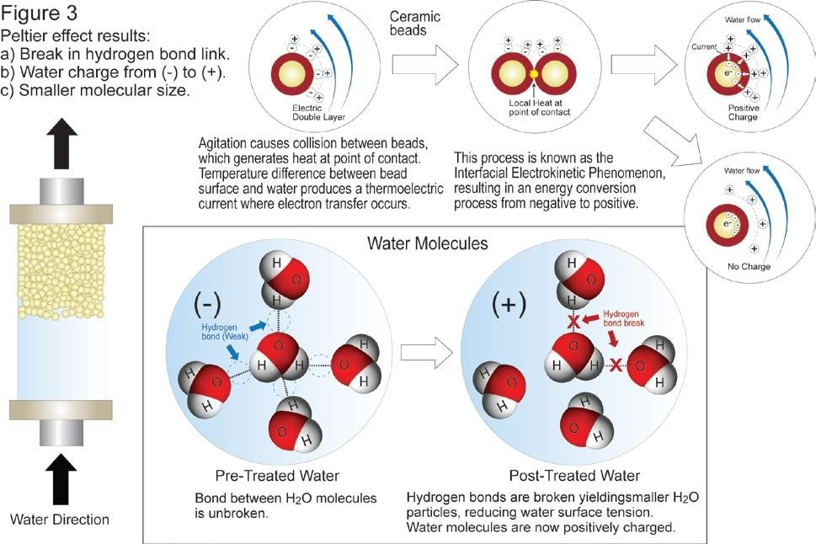
HOW DOES AMB WORK ? – Illustrated Explanation No.1
The following is an abridged pictorial explanation of AMB:
The basics concerning our technology are our proprietary quartz-like ceramic beads and engineering design which are used to create a process that positively charges water thereby changing the water’s molecular structure and releasing the water’s hydrogen atoms. This alteration of the water molecules provides many benefits including reduced surface tension of the water enabling our converted water to more easily enter the cells of humans, plants and animals.
Water molecules are made up of hydrogen and oxygen atoms, with each molecule containing 2 hydrogens and 1 oxygen. Untreated Water [H2O] holds a negative (-) charge. (see Figure 1 on the next page)
In Cationized water methodology Beads are negatively charged, and treated at 1200 degree and negative charge on surface is created.. A layer of negatively charged anions (-) forms on the beads’ surface area. (see Figure 2 on the next page)

Slide 4
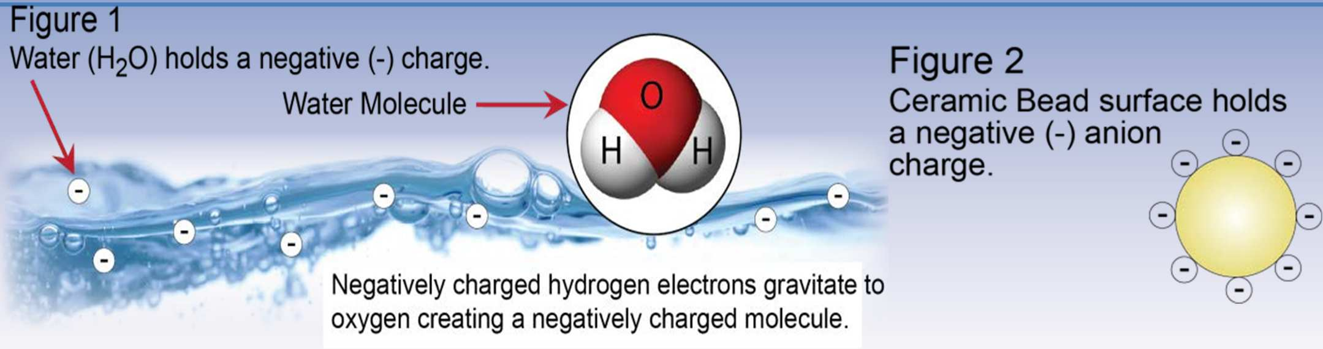
HOW DOES AMB WORK ? – Illustrated Explanation No.2
The agitation of beads within the activation chamber causes them to collide with one another creating what is known as the Peltier effect. A second positively charged layer (cation) is created on top of the beads negatively charged surface layer (anion) known as an electric double layer. (Figure 3 on the next page)
Where there is friction there is energy (heat) release. This is known as the Interfacial Electrokinetic Phenomenon. This action produces a conversion channel where electron transfer occurs changing the water’s structure by breaking the hydrogen/oxygen bonds between each molecule. Surface tension reduction and other benefits result.

Slide 5
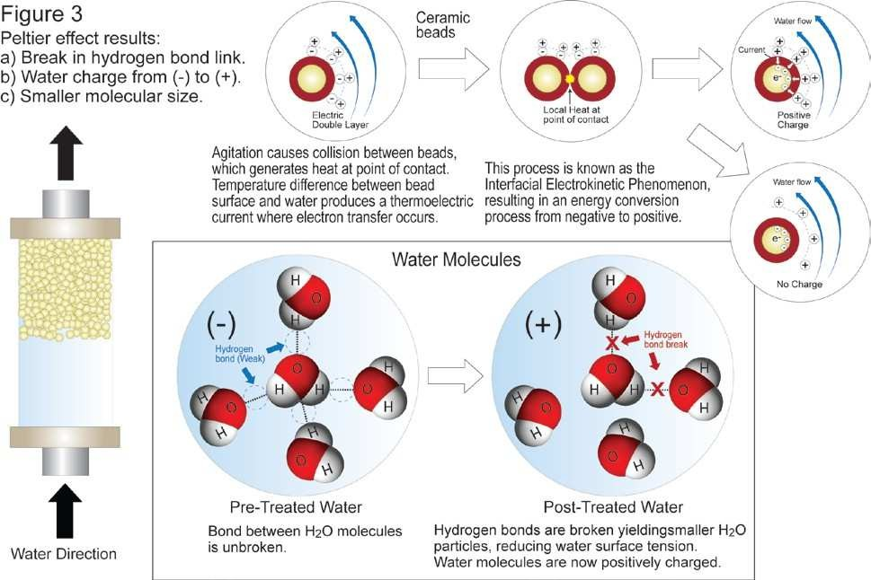
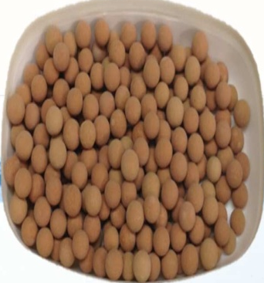
HOW DOES AMB WORK ? – Illustrated Explanation No.3

Slide 6
Benefits/Effects of AMB
Removes Scale & Slime – Enhances water quality while reducing chemical cleaning costs and regular maintaining of pipes and equipments.
Unlike Conventional softeners, AMB effectively handles silica based (si has anion and softners are for cation ca/mg) hardness & require Zero chemical, power or maintaince.
Anti corrosion: Metal rust when it lose electron."AMB lowers the electric potential of iron, transforming Fe₂O₃ (ferric oxide) into Fe₃O₄ (magnetite) to prevent rust and corrosion. It also ionizes water to coat zinc and copper pipes, further protecting against corrosion.“
Reduce Surface Tension – Increase wetting, mixing, and heat transfer.
Making water as ideal solvent for various applications.
Antimicrobial & Antioxidant effects – Restraint of the growth of Ecoli and bacterium !Supports health benefits in medical ,pharmaceutical , food product based and various applications.
Extends pipeline longevity & Optimizes Energy transfer– Reduces scale, slime, and sludge, lowering energy and maintenance costs.
Eliminates chemical agents, Ecofriendly solution – Provides a sustainable, nonchemical solution which is maintaince free.
Ideal for fresh produce (Antimicrobial and anti oxidants Properties) – Enhances water quality, benefiting vegetables, fruit markets & eatables.

Slide 7


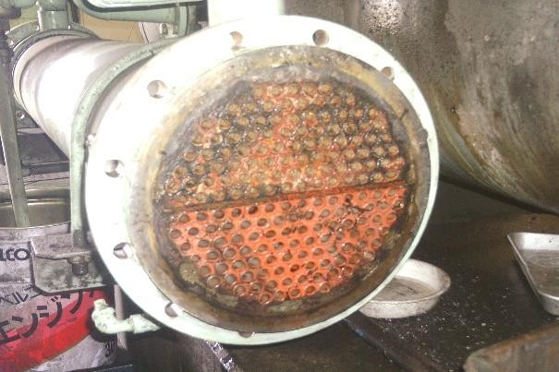
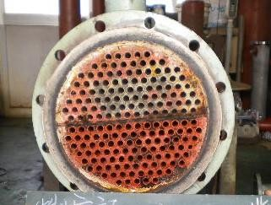
EFFECTS OF AMB
The abovementioned effect can lead to the following effect :
  Water can be absorbed very easily by human, animals and plants and goes into their cells smoothly.
  Water can have the stronger cleansing effect
  Scale and slime can be removed dramatically and corrosion of a pipe can be restrained.
  Saving of a lot of water can be possible.
  I t has also been proved that AMB can provide antioxidant and antimicrobial effect to water including the restraint of the growth of Ecoli and bacterium !
Remarkable Difference ! Shell & Tube :
Without AMB
With AMB

Slide 8



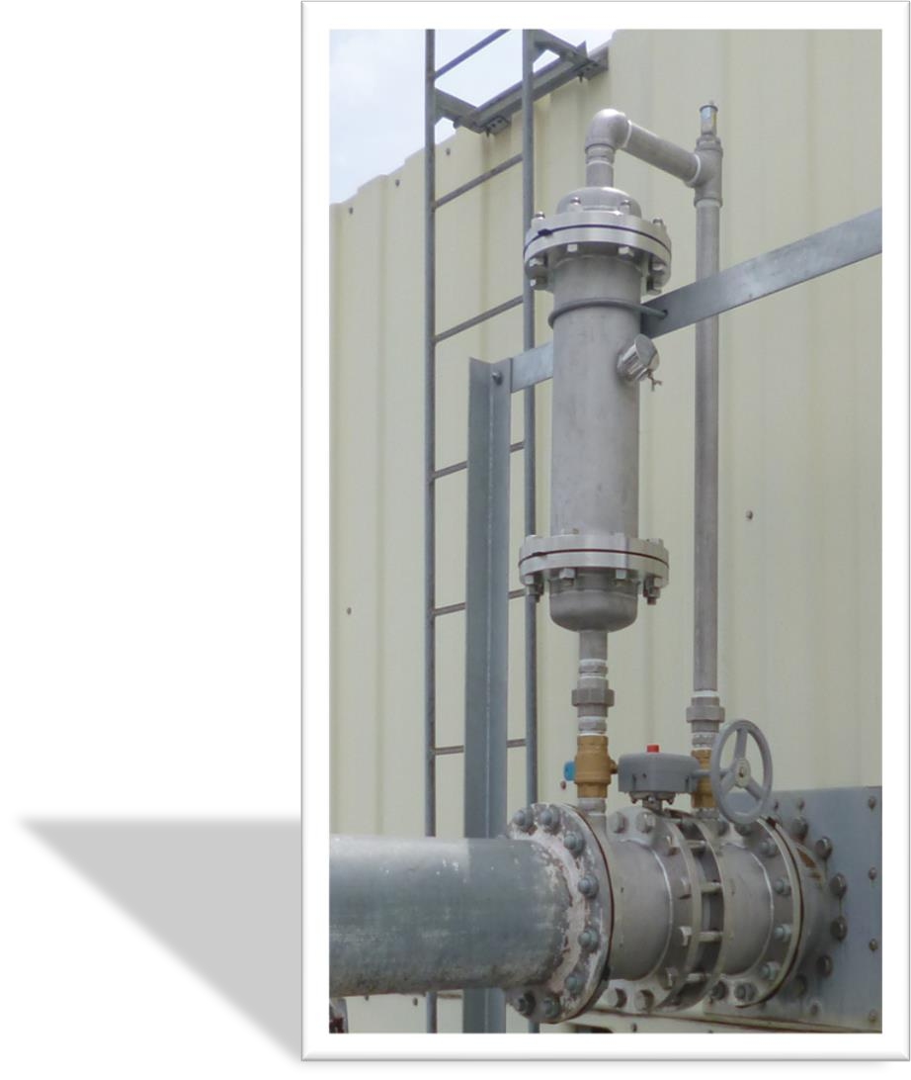
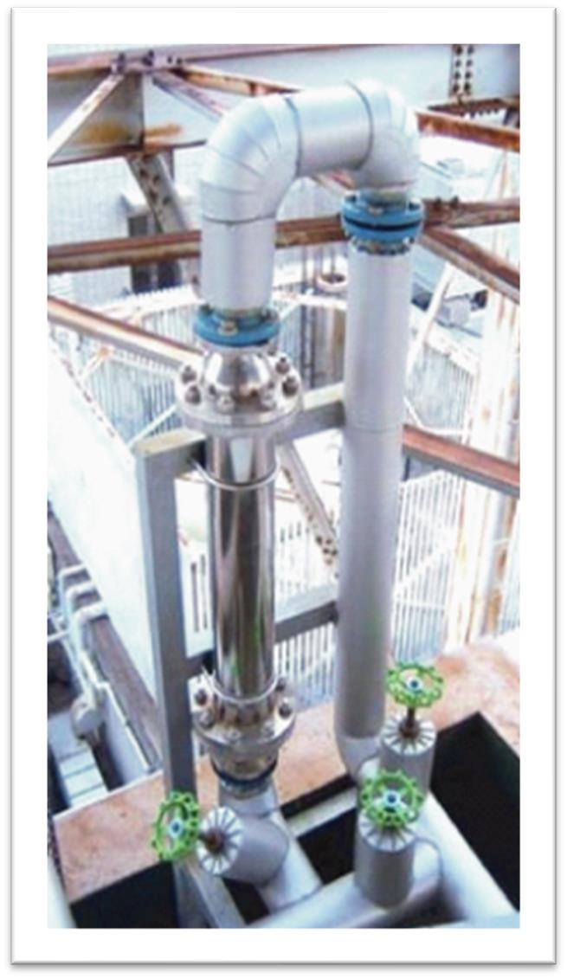
APPLICATIONS
Industrial Commercial

Slide 9
Limitation of AMB
1.AMB alone is Not Effective for High-Purity Water Needs (0 PPM )
AMB cannot produce 0 (Zero) PPM hardness or ultra-pure water required in industries like pharmaceuticals, semiconductors, and high-end and high pressure boilers with 0 PPM requirement.
2. Limited Impact on Dissolved Solids (TDS)
AMB does not remove dissolved salts, heavy metals, or contaminants like fluoride, arsenic, and nitrates, unlike RO systems but make insoluble non sticky colloids of hardness causing element.
3. In Extremely Hard Water, LTI with simple filtration is needed:
In cases where hardness exceeds 600 PPM, additional filtration may be required to arrest the colloids. But with simple filtration with LTI it can replace ion exchange or RO unit.
4. AMB does not replace but Supports existing installed traditional Water Treatment system with ultra pure water requirement :
Enhances RO systems, Ion Exchange, and Ultra-Pure Water Applications can be worked in conjunction with AMB by reducing the regular maintaince cost, increasing the life of membrane by 50-60 %. For Ion Exchange: Reduces resin fouling, lowering regeneration needs by 40-50%

Slide 11
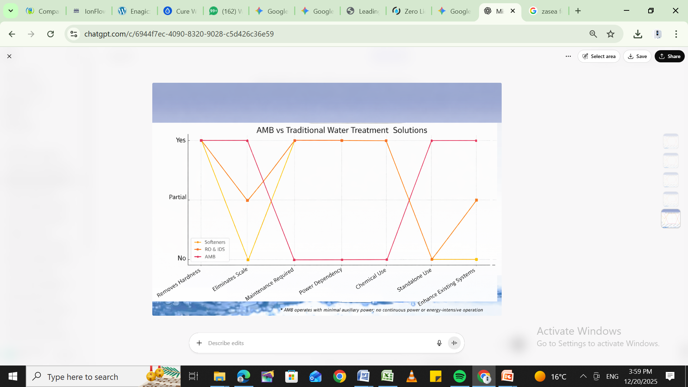

Slide 12
Application Sector | AMB Benefits
Industrial Cooling Towers | Prevents scale & rust, reduces chemical use, improves efficiency
Power Plants | Reduces scaling in boilers & cooling systems, extends equipment lifespan
Sugar Mills | Prevents scale in evaporators & heat exchangers, reduces maintenance costs
Distilleries & Breweries | Improves water quality, enhances fermentation efficiency, reduces biofouling
Textile & Leather Industry | Prevents scale in dyeing machines, reduces chemical use, improves fabric quality
Edible Oil Mills | Reduces scaling in processing equipment, improves oil extraction efficiency
Milk & Dairy Processing | Eliminates biofilm & bacteria, improves hygiene, extends shelf life
Ice Cream & Packaged Food | Enhances product quality, prevents microbial contamination
Agricultural Greenhouses | Reduces water & fertilizer consumption, increases crop yield
Hospitals & Public Places | Improves sanitation, reduces odors, prevents pipe scaling
Concrete Industry | Reduces water & chemical usage, strengthens concrete
Swimming Pools | Reduces chlorine use, prevents corrosion, improves water clarity
Livestock Farming | Reduces antibiotic use, improves animal health & growth
Household & Laundry | Improves washing efficiency, reduces detergent & chemical use
Ships, Trains & Aircraft | Prevents scale, eliminates biofouling, reduces maintenance costs
Medical Dialysis Equipment | Extends RO membrane life, reduces contamination risk
Packaged Meat & Food Storage | Extends shelf life, prevents bacterial contamination
Agricultural Irrigation | Improves water absorption, reduces pesticide & fertilizer use

